Slide 1
Shopping Experience Through Artificial Intelligence
Nasibullah Qarizada

Slide 2
Outline
Introduction
Statistical Analysis
Statistical Testing
Machine Learning
Natural Language Processing

Slide 3
1. Introduction

Slide 4
Introduction to Research
Usage of Explainable A.I. With Augmented Reality in shopping
Comparing different scenarios
Data collected by an online survey

Slide 5
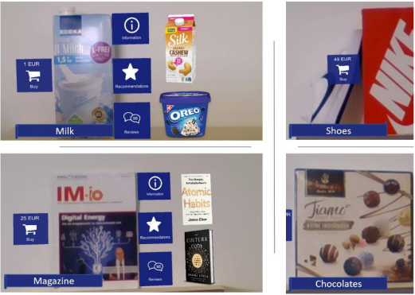
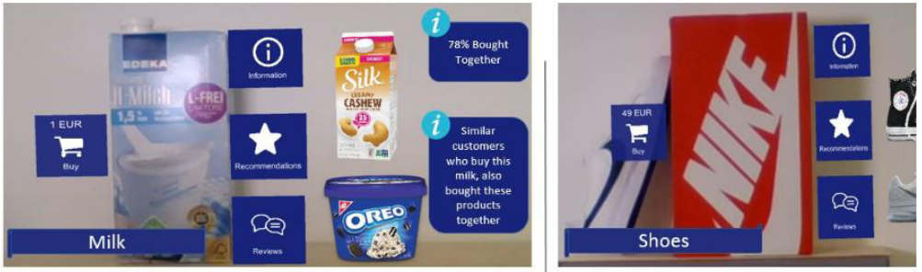
Shopping Scenarios
ARSS
RSS: Regular Shopping Scenario
ARSS: Augmented Reality Shopping Scenario
EARSS: Explainable A.I. Augmented Reality Scenario
EARSS

Slide 6
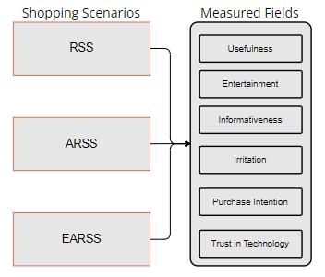
Data collection
Data collected through an online survey.
Presented questions regarding to all scenarios.
Questions measuring 6 different fields.

Slide 7
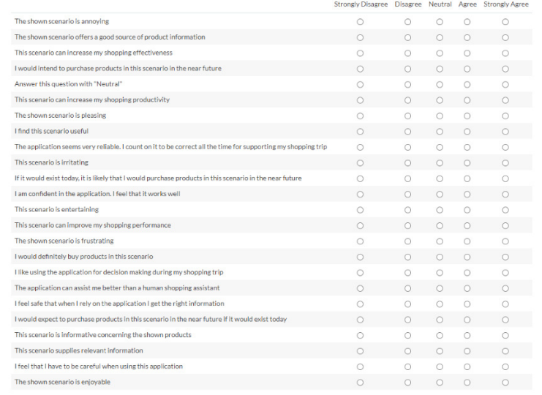
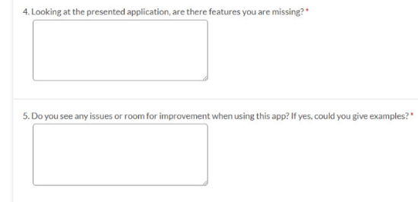
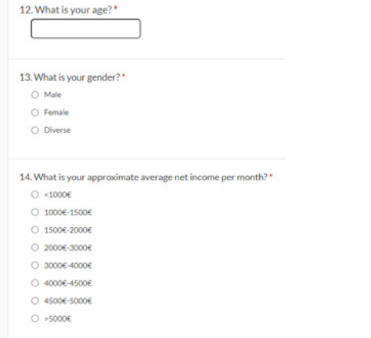

Slide 8
Research Structure
Fetching Dataset
Pre-Processing
Statistical Analysis
Machine Learning
Visualizations
Statistical Tests
Text Analysis

Slide 9
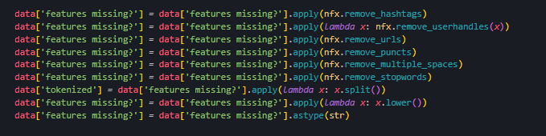
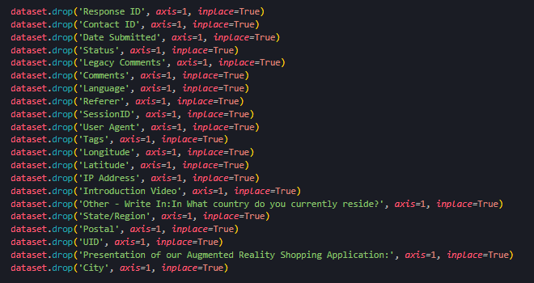
Pre-Processing
Several Pre- Processing Methods Applied

Slide 10
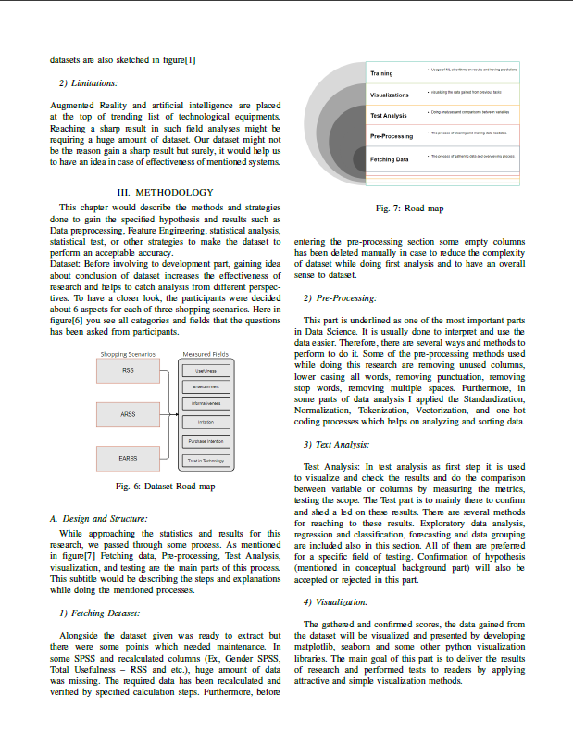
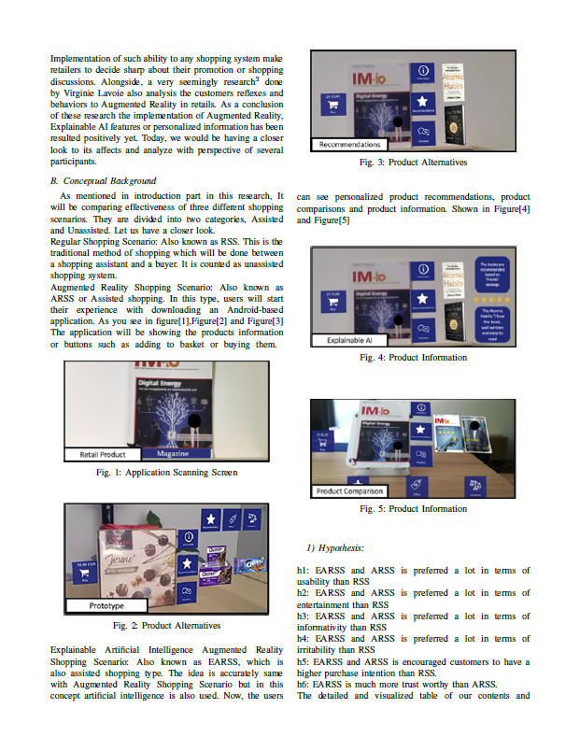
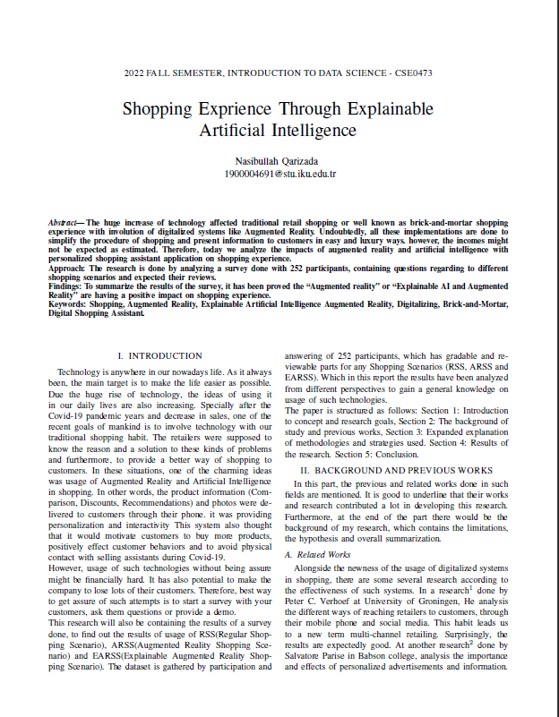

Slide 11
2. Statistical Analysis

Slide 12
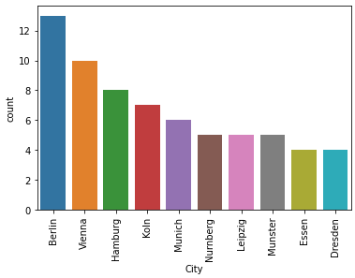
Our Audience
Participants were mainly participated from Germany, Austria and USA.

Slide 13
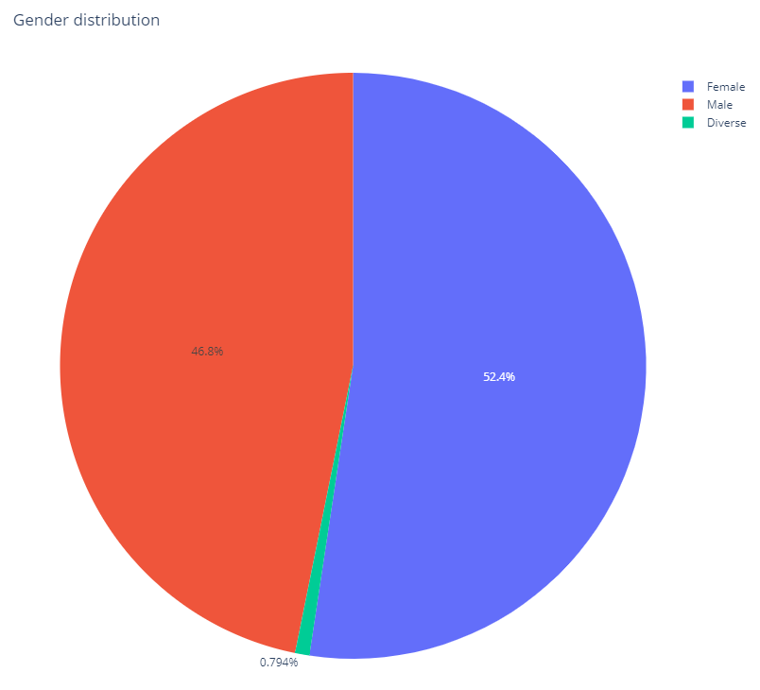
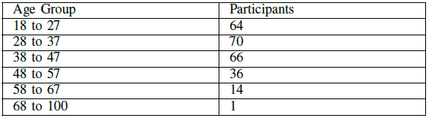
Our Audience
52.4% Female (132)
46.8% Male (118)
0.79% Diverse (2)
Mostly between 20 to 40 ages

Slide 14
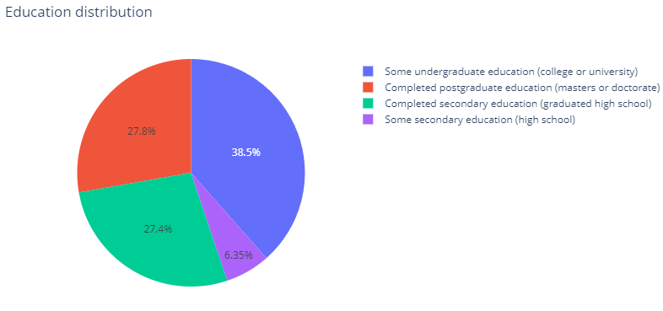
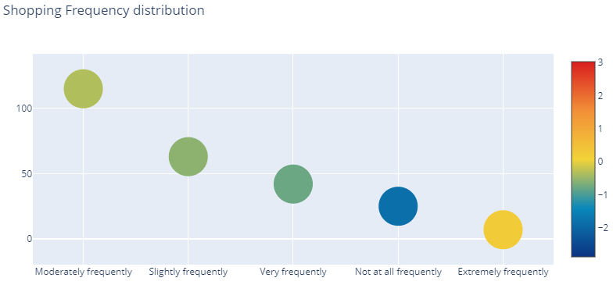
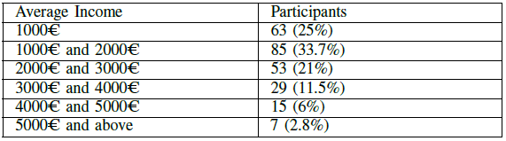
Our Audience

Slide 15
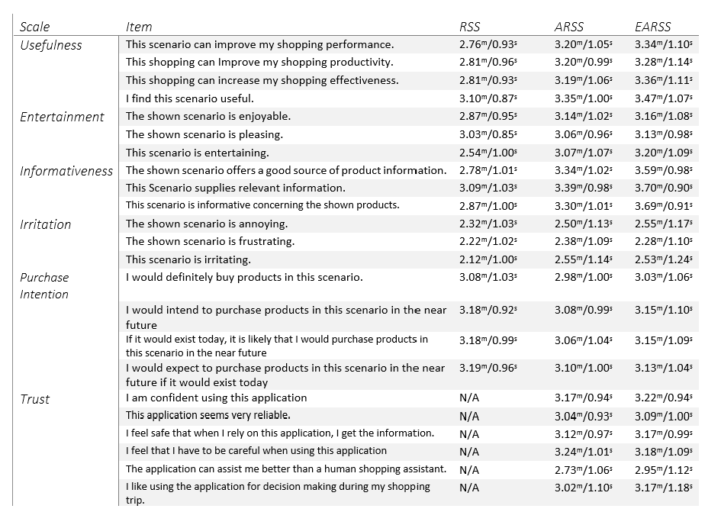
General Analysis

Slide 16
Hypothesis
h1: EARSS and ARSS is preferred a lot in terms of usability than RSS
h2: EARSS and ARSS is preferred a lot in terms of entertainment than RSS
h3: EARSS and ARSS is preferred a lot in terms of informativity than RSS
h4: EARSS and ARSS is preferred a lot in terms of irritability than RSS
h5: EARSS and ARSS is encouraged customers to have a higher purchase intention than RSS.
h6: EARSS is much more trustworthy than ARSS.

Slide 17
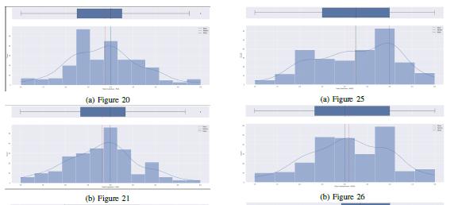
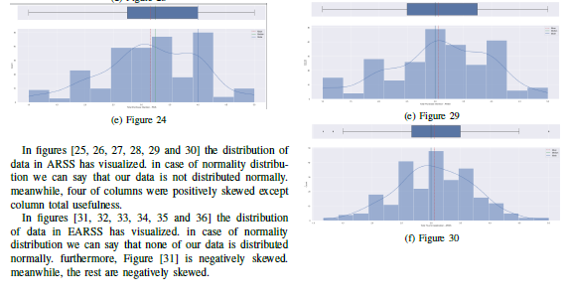
Normality Distribution
Could be checked analytically and graphically
Distribution analysis on each column
The ability to apply Parametric or Non-Parametric tests

Slide 18
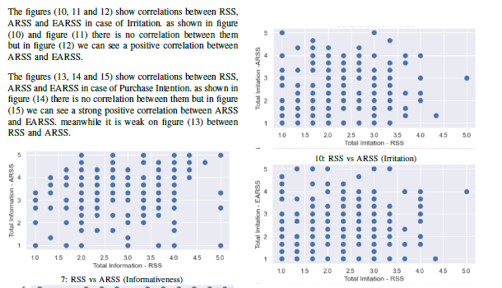
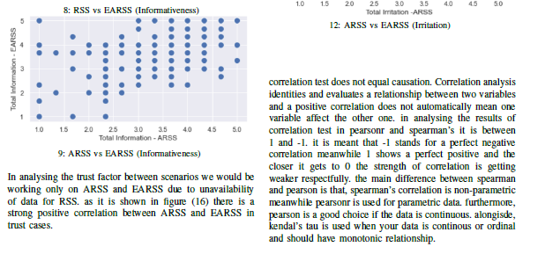
Correlation Analysis
Done between two variables
Get to know strength and connection between data
Rapid hypothesis testing

Slide 19
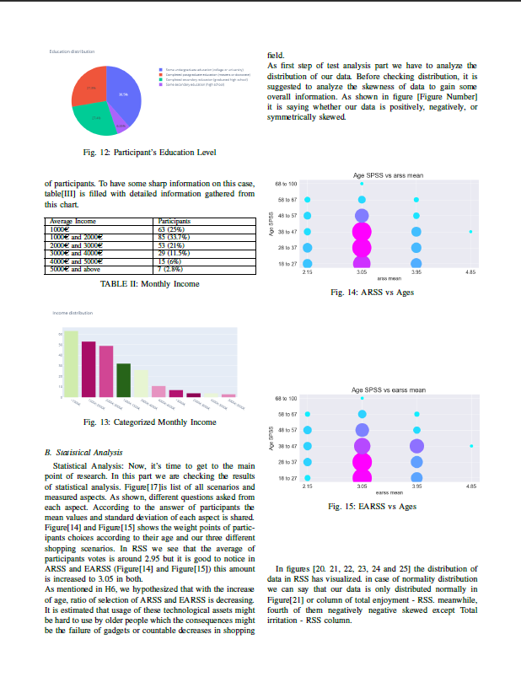
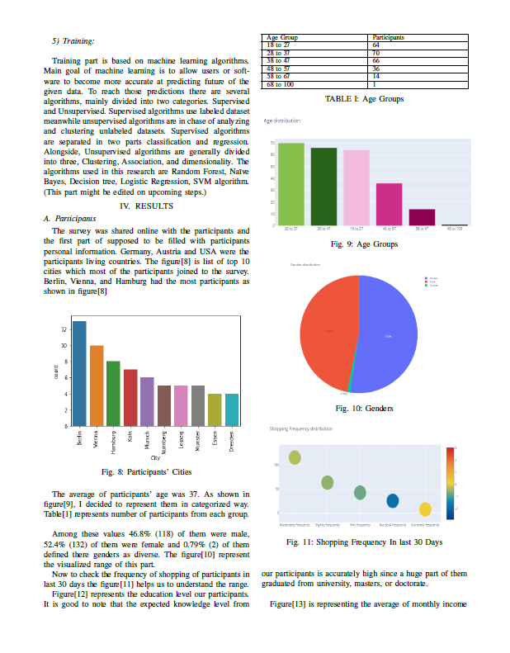
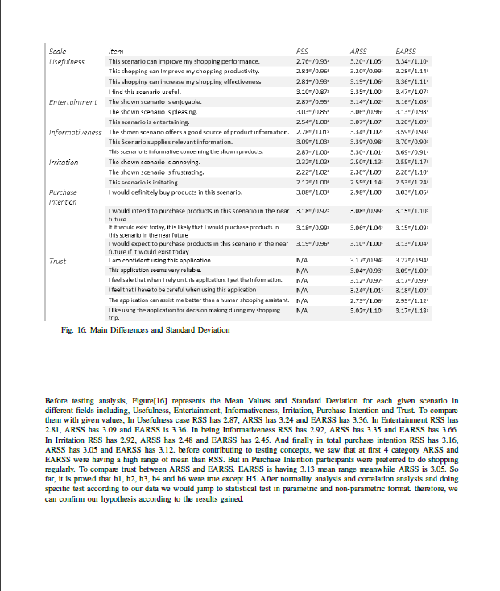

Slide 20
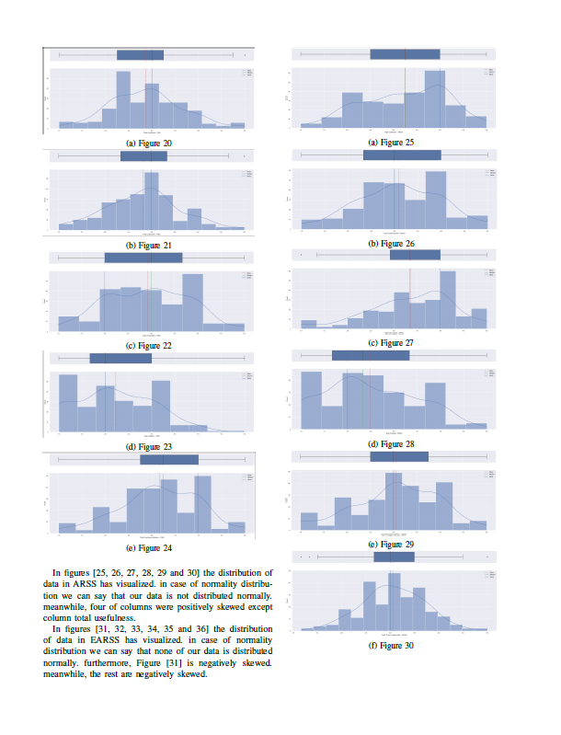
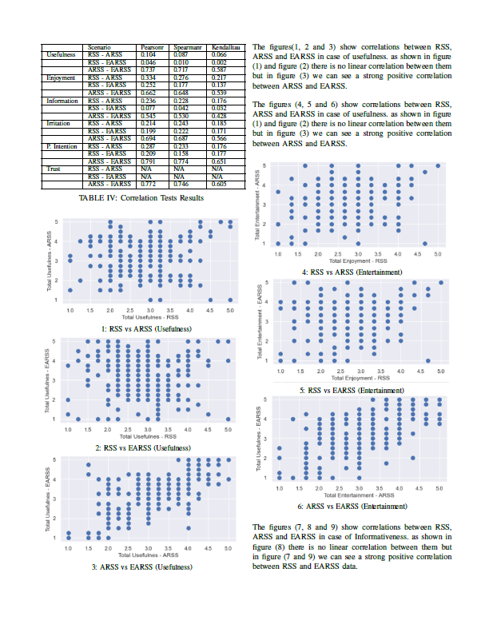
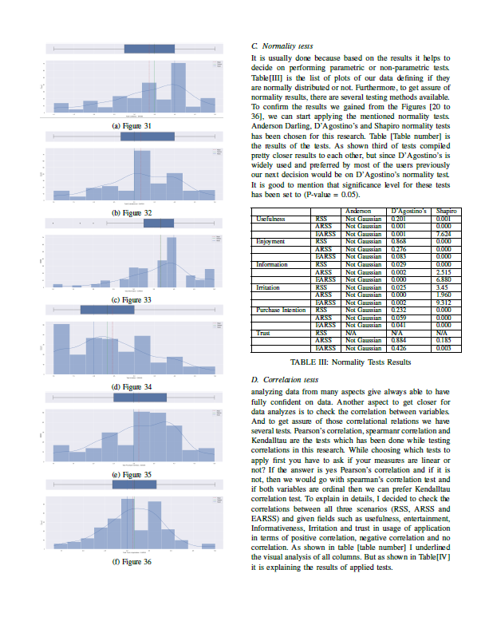

Slide 21
3. Statistical Test

Slide 22
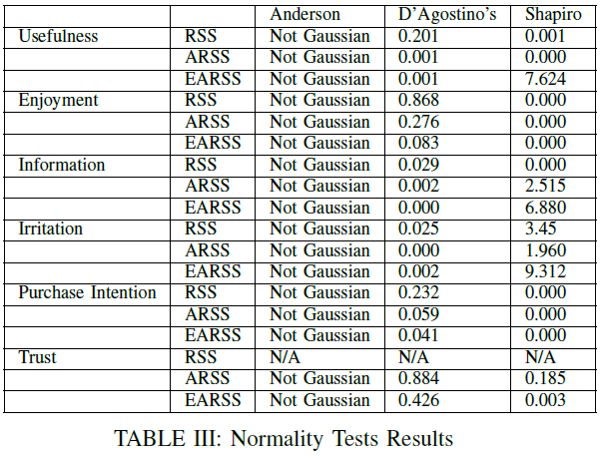
Normality Tests
Most of the data assumed normally distributed
D’Agostino’s preferred cause it was the ideal for our data type.
Significance level is 0.05 (P value Greater than significance level is assumed normally distributed.)

Slide 23
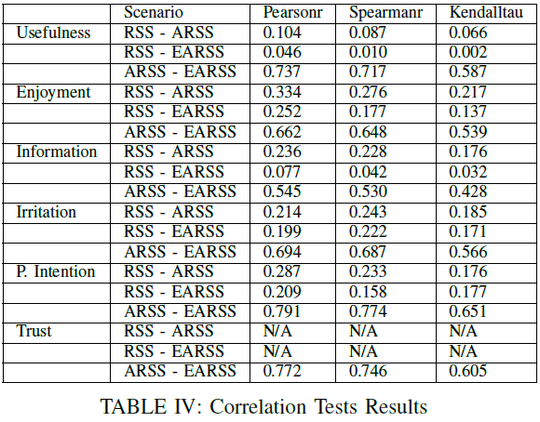
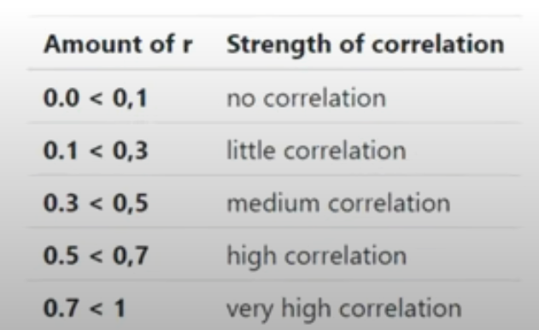
Correlation Tests
As mentioned, done between two column
Get to know strength and connection between data
Positive and Negative Correlation
Pearson is good for our data

Slide 24
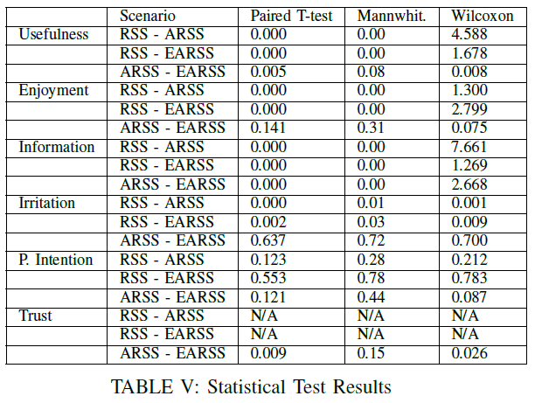
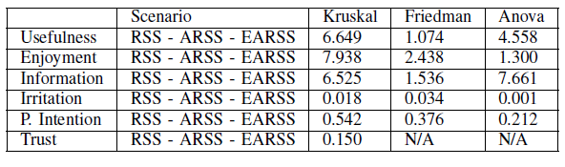
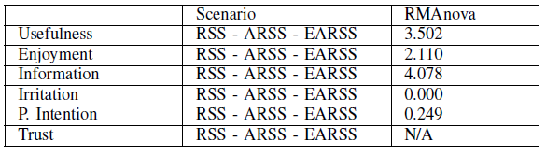
Hypothesis Testing
Paired T-Test is suitable for our dataset.

Slide 25
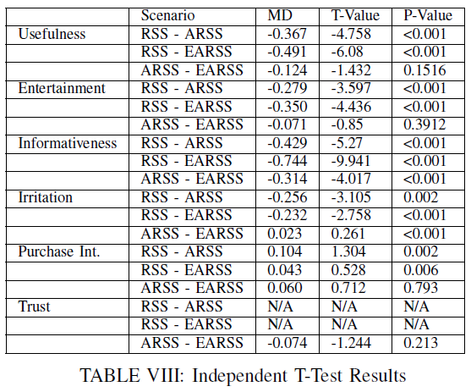
Hypothesis Testing

Slide 26
Hypothesis Testing Results
h1: EARSS and ARSS is preferred a lot in terms of usability than RSS (Accepted)
h2: EARSS and ARSS is preferred a lot in terms of entertainment than RSS (Accepted)
h3: EARSS and ARSS is preferred a lot in terms of informativity than RSS (Accepted)
h4: EARSS and ARSS is preferred a lot in terms of irritability than RSS (Accepted)
h5: EARSS and ARSS is encouraged customers to have a higher purchase intention than RSS. (Rejected)
h6: EARSS is much more trustworthy than ARSS. (Accepted.)

Slide 27

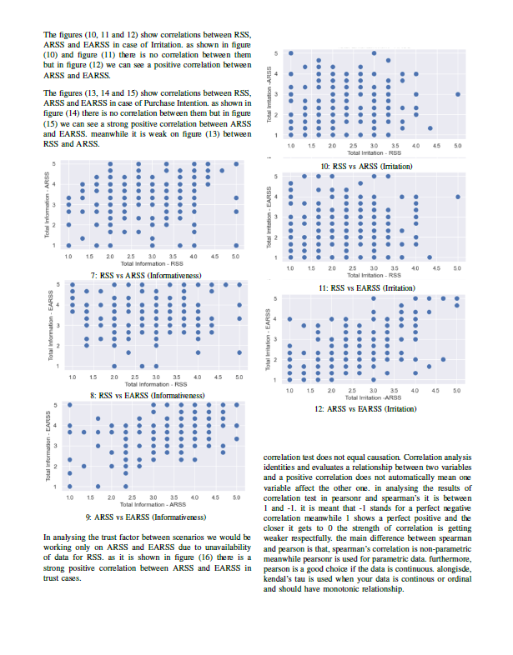
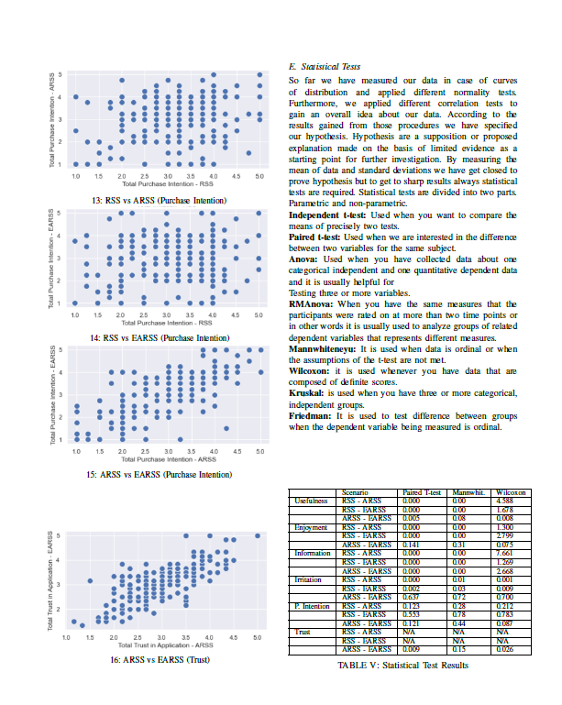

Slide 28
4. Machine Learning

Slide 29
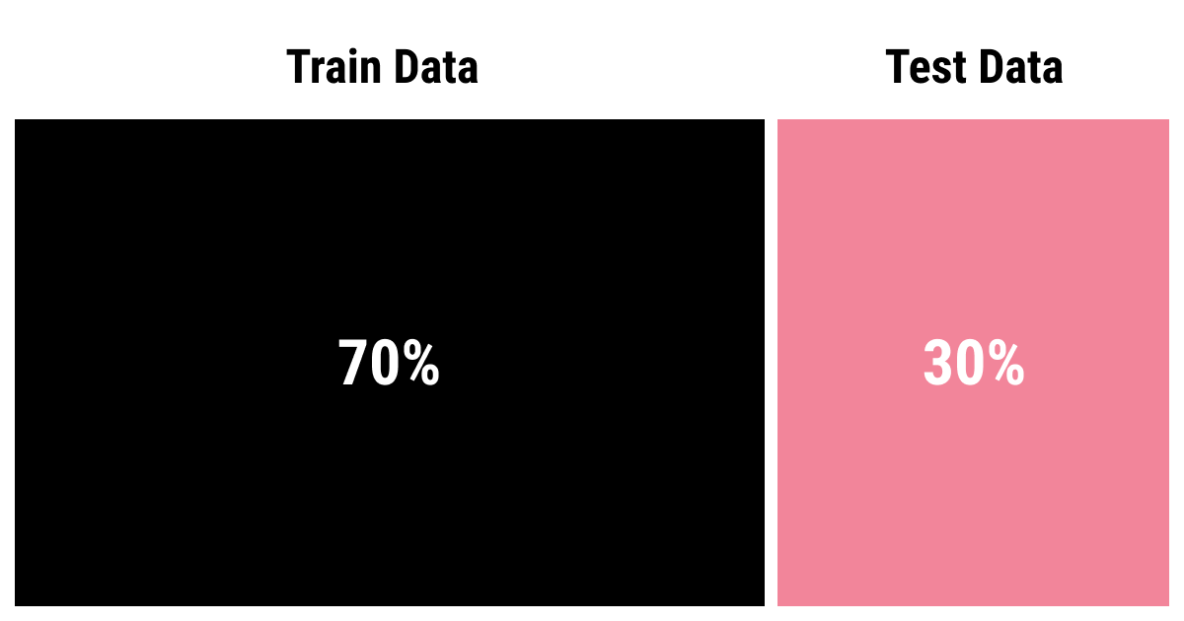
Machine Learning
Train and Test data into 70%/30%.
Created a different datasets and different models for each scenario
Applied different models
Applied Cross Validation

Slide 30
Machine Learning Algorithms
Logistic Regression
Decision Tree Classifier
K- Neighbors
Support Vector Machine
Random Forrest Classifier

Slide 31
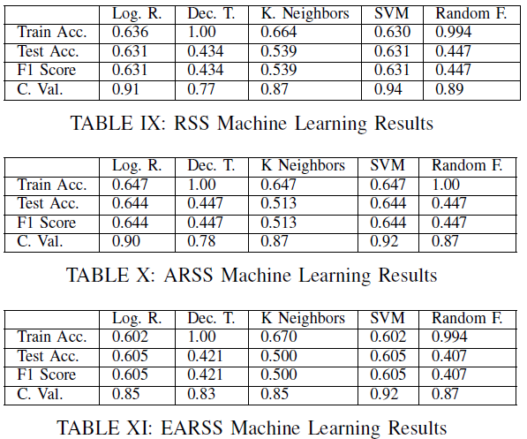
Machine Learning Results
Received Accuracies were low.
Increase after performing Cross Validation.

Slide 32
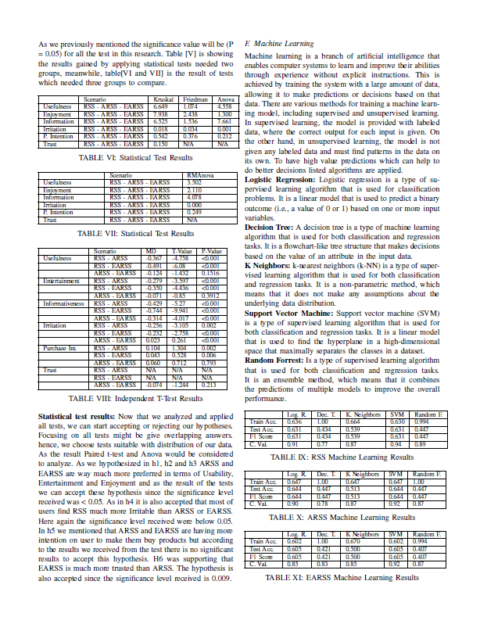
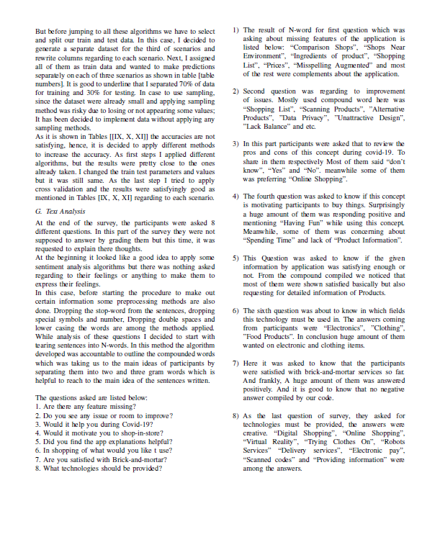

Slide 33
5. Natural Language Processing

Slide 34
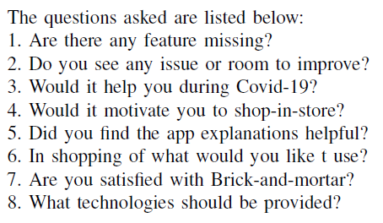
Text Analysis
Different questions asked but to explain
Requested Ideas
Analyzed the compound words

Slide 35
Generated Compound Words
1. | “Comparison Shops”, ”Shops near environment”, ”Ingredients of product”, ”shopping”
2. | “Shopping List”, “Scanning Products, “Data Privacy”, “Unattractive Design”
3. | Answers usually consisted of “Yes”, ”No” and “Don’t know”.
4. | Huge amount of “Having Fun” and positivity, some of them founded as waste of time.
5. | Mostly “Yes”, some participants requested for more information.
6. | “Electronics”, ”Clothing”, ”Food Products”
7. | Mainly satisfied.
8. | “Online Shopping”, ”Virtual Reality”, Trying Clothes on”, ”Robot Services”, Electronic Pay”.

Slide 36
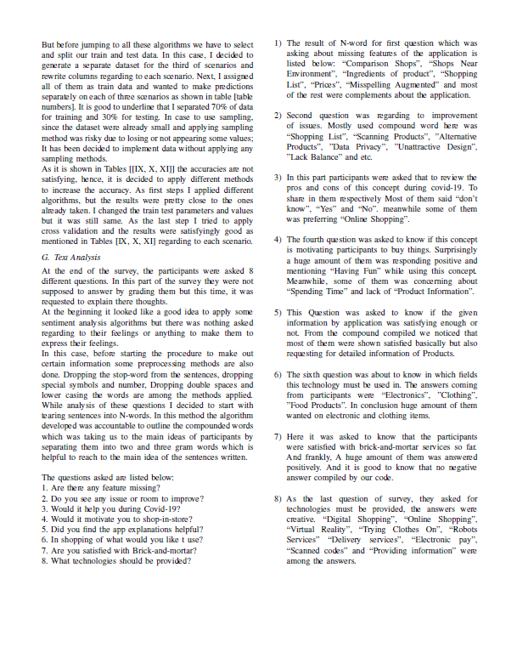
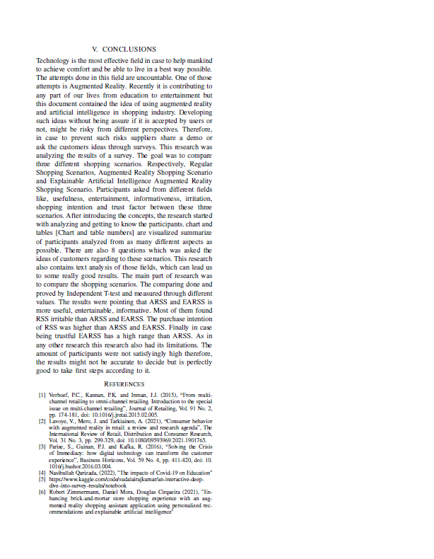

Slide 37
Summary
In conclusion, after fetching dataset and applying several different pre-processing we visualized our dataset from as many aspects as possible. Defined some hypothesis and to accept or reject them we did normality tests, correlation test and hypothesis tests. We’ve developed machine learning models to predict the data regarding to three different shopping scenario and finally applied a model to generate compound words in natural language processing part.

Slide 38
Thank you
Nasibullah Qarizada
Computer Science Engineering

